Slide 1



SQA Reviews

Slide 2
What is a Review?
A process or meeting during which a work product, or a set of work products, is presented to project personnel, managers, users, or other interested parties for comment or approval. Types include code review, design review, formal technical review, requirements review, test readiness review
[IEEE Std. 610.12-1990]

Slide 3
Objectives of Reviews
Identify required improvements in a product
Assure that the deliverable is complete
Assure that the deliverable is technically correct
Measure the progress of the project

Slide 4
Objectives of Reviews
Identify any defects early, thus resulting in cost and time savings
Assure the quality of deliverable before the development process is allowed to continue
Once a deliverable has been reviewed, revised as necessary, and approved, it can be safely used as a basis for further development

Slide 5
Kinds of Reviews
Business reviews
Technical reviews
Management reviews
Walk-throughs
Inspections

Slide 6
Objectives of Business Reviews
The deliverable is complete
The deliverable provides the information required for the next phase
The deliverable is correct

Slide 7
Objectives of Technical Reviews
Point out needed improvements in the product of a single person or a team
Confirm those parts of a product in which improvement is either not desired or not needed
Software reviews are a “filter” for software engineering process

Slide 8
Objectives of Technical Reviews
Another reason we need technical reviews is that although people are good at catching some of their own errors, large classes of errors escape the originator more easily than they escape anyone else

Slide 9
Objectives of Management Reviews
Validate from a management perspective that the project is making progress according to the project plan
Ensure a deliverable is ready for management approval
Resolve issues that require management’s
attention

Slide 10
Software Inspections are a disciplined engineering practice for detecting and correcting defects in software artifacts, and preventing their leakage into field operations. In a review , a work product is examined for defects by individuals other than the person who produced it. .
In a Walkthrough, the producer describes the product and asks for comments from the participants. These gatherings generally serve to inform participants about the product rather than correct it.

Slide 11

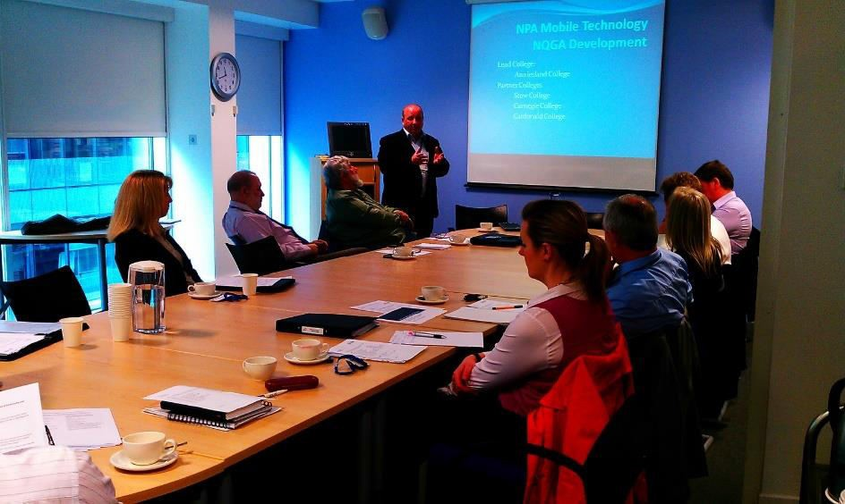
Review Roles

Slide 12
Review Roles
Facilitator
Author
Recorder
Reviewer
Observer

Slide 13

Responsibilities of Facilitator
Responsible for providing the background of the work and assigning roles to attendees
Encourages all attendees to participate
Keeps the meeting focused and moving
Responsible for gaining consensus on problems

Slide 14

Responsibilities of Author
Responsible for the readiness and distribution of material to be reviewed
During the meeting, the author paraphrases the document a section at a time

Slide 15
Responsibilities of Author
Responsible for
scheduling the review
selecting the review participants
determining if the entry criteria for the review are met
providing information about the product during all stages
clarifying any unclear issues
correcting any problems identified
providing dates for rework and resolution

Slide 16

Responsibilities of Recorder
Collects and records each defect uncovered during the review meeting
Develops an issues list and identifies whose responsibility it is to resolve each issue
Records meeting decisions on issues; prepares the minutes; and publishes the minutes, and continually tracks the action items

Slide 17

Responsibilities of Reviewer
Spends time prior to the meeting reviewing information
Makes notes of defects and becomes familiar with the product to be reviewed
Identifies strengths of the product
Verifies that the rework is done

Slide 18

Responsibilities of Observer
A new member to the project team, who learns the product and observes the review techniques.

Slide 19
Review Guidelines
Preparation
Discussions
Respect
Agenda
Review Records
Resources
Attendees

Slide 20
Review Frequency
At the beginning/end of the requirements phase
At the beginning/end of the design phase
At the beginning/end of the code phase
At the beginning/end of the test phase
Approval of the test plan

Slide 21

Review Planning
Distribute review package one week in advance
Document to be reviewed
Review agenda
Identification of the individual who will manage
the agenda and schedule
Exit and entrance criteria for the review
Objective of the review
Names of attendees, their roles and responsibilities

Slide 22
Review Planning
Distribute review package one week in advance
Review location
Date and time of review
List of classifications that will be used for defects discovered (defect type, defect origin, and defect severity)
Procedures for handling issues raised during the review

Slide 23


Review Meeting
Facilitator begins the meeting with an introduction of agenda, people, and description of their roles
Author of the document proceeds to explain the materials, while reviewers raise issues based on advance preparation

Slide 24
Review Meeting
When valid problems, issues, or defects are discovered, they are classified according to their origin or severity and then recorded
These are accompanied with the names of individuals who are responsible for resolution and the time frame during which the item will be resolved
Related recommendations are also recorded

Slide 25
Decisions at the End of a Review Meeting
All attendees must decide whether to
Accept the product without further modification
Reject the product due to severe errors
Accept the product provisionally
Hold a follow-up review session

Slide 26
Rework
It is the responsibility of project manager to ensure that all defects identified in the review are fixed and retested

Slide 27
Follow-Up
During the follow-up, that all discrepancies identified are resolved and the exit criteria for the review have been met
Document lessons learned during the final report also

Slide 28
Class Activity: Software Review
In small groups, select one software application to review.
Assume the roles of facilitator, author, recorder and reviewer.
Thoroughly explore the chosen software application, examining aspects such as user interface design, ease of navigation, functionality, performance, and user experience.
Take notes and screenshots to support your analysis.
Present your findings in a brief report, discussing the strengths and weaknesses of the software application based on your analysis.

